Slide 1
MODULE 2
Creating a
Supportive Classroom Climate
Second Edition
Page ▪ 1

Slide 2
Disclaimer
The contents of the Creating a Safe and Respectful Environment in Our Nation’s Classrooms training toolkit were designed and written under the U.S. Department of Education (Department) Contract Numbers ED-ESE-12-O-0035 and ED-ESE-16-A-0002 by the National Center on Safe Supportive Learning Environments (NCSSLE) operated by the American Institutes for Research. The content and views expressed herein do not necessarily represent the policies of the Department and should not assume endorsement by the federal government. No official endorsement by the Department of any product, commodity, service, or enterprise mentioned in this publication is intended or should be inferred. For the reader’s convenience, this publication contains information about and from outside organizations, including material obtained by way of hyperlinks and URLs. Inclusion of such information does not constitute the Department’s endorsement.
Second Edition
October 2018
This training package is in the public domain. Authorization to reproduce it in whole or in part is granted. While permission to reprint this product is not necessary, the following is the preferred citation:
Diamanti, K., Duffey, T., & Fisher, D. (2018). Creating a safe and respectful environment in our nation’s classrooms. Washington, DC: National Center on Safe Supportive Learning Environments.

Slide 3
Introductions
Your name.
School(s) for which you work.
What subjects do you teach, and how long have you been teaching?
When you close out your career as an educator, how would you like to be remembered by your students?
Page ▪ 3

Slide 4
Workshop Objectives
Participants will:
Consider what a supportive classroom climate looks like and how it can prevent bullying.
Examine the role of teacher-to-student and student-to-student relationships in building a supportive classroom climate.
Explore strategies for preventing bullying in the classroom, including establishing a culture of respect for differences among students.
Consider how a web of positive support among students and other adults across the school community can help prevent bullying.
Identify and commit to use one new strategy for preventing bullying in their daily work with students.
Page ▪ 4

Slide 5
What Is Bullying?
Bullying is unwanted, aggressive behavior among students that involves an observed or perceived imbalance of power. The behavior is repeated multiple times or is highly likely to be repeated.
Page ▪ 5
Citation ▪ 12
Notes:
Citation (12)

Slide 6
Core Elements of Bullying Behaviors
Bullying is a form of youth violence that includes:
Unwanted, aggressive behavior
An observed or perceived imbalance of power between the student(s) doing the bullying and the student(s) being bullied
Behavior that is repeated multiple times or is highly likely to be repeated
Page ▪ 6
Citation ▪ 12
Notes:
Citation (12)

Slide 7
A Supportive Classroom
What would you see going on in a classroom in which there is a supportive climate for students?
How would teachers be relating to their students and students with each other?
What three words would you use to describe a supportive classroom climate?
Page ▪ 7

Slide 8
Supportive Classroom Settings
Engagement: Strong relationships between students, teachers, families, and schools and strong connections between schools and the broader community. Encompasses respect for diversity and school participation.
Safety: Schools and school-related activities where students are safe from violence, bullying, harassment, and controlled-substance use. Encompasses emotional and physical safety.
Environment: Appropriate facilities, well-managed classrooms, available school-based health supports, and a clear, fair disciplinary policy. Encompasses the physical, academic, and disciplinary environments and wellness.
Page ▪ 8
Citation ▪ 10
Notes:
Citation (10)

Slide 9
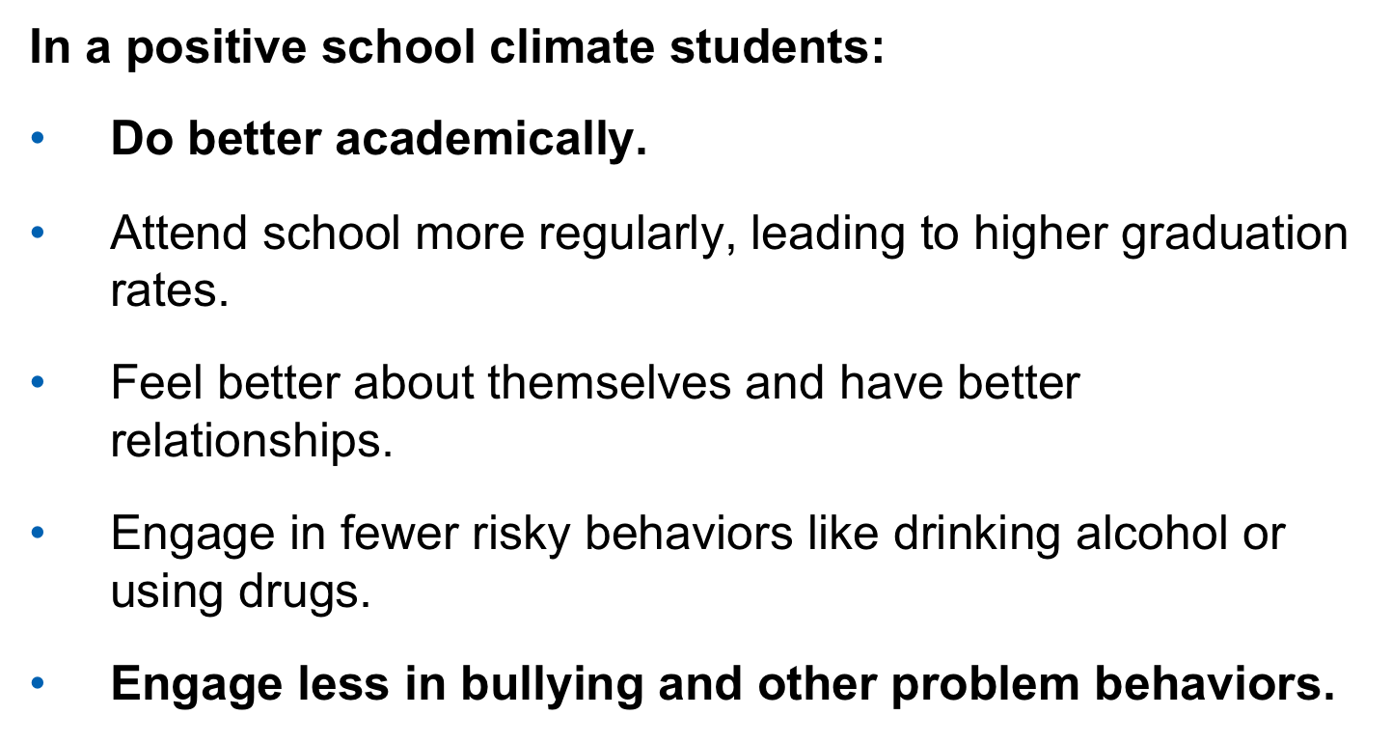
Effects of a Positive Classroom Climate
Page ▪ 9
Citations ▪ 5, 7, 10
Notes:
Citation (5, 7, 10)

Slide 10
Willingness to Intervene
When teachers and staff feel valued, they are more likely to become involved and intervene in a bullying situation.
When teachers and paraeducators report high levels of connectedness, they report greater comfort levels intervening in a bullying situation.
Feelings of comfort in being willing to intervene are correlated to:
Knowing effective intervention strategies
Perception that others in the school are also likely to intervene
Page ▪ 10
Citation ▪ 3
Notes:
Citation (3)

Slide 11
A Relationship Issue
Bullying is a relationship problem that requires a relationship solution.
Page ▪ 11
Citation ▪ 6
Notes:
Citation (6)

Slide 12


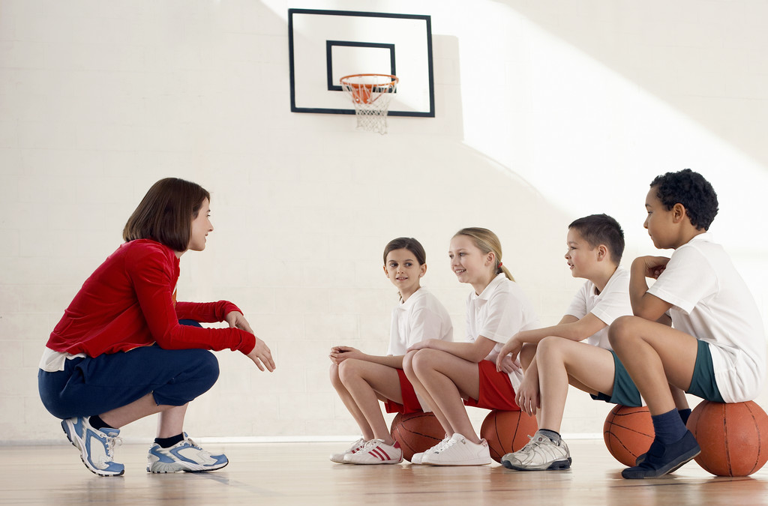
Who Was There for You?
Page ▪ 12

Slide 13

The Important Things That Teachers Do
Be available.
Listen to me.
Be positive.
Have fun.
Be real.
Page ▪ 13
Citations ▪ 5, 9
Notes:
Citation (5, 9)

Slide 14
Student Intervention
Bullying almost always occurs in front of other students. One study found that peers were present in 85% of bullying episodes but intervened in only 10%.
In the majority of bullying episodes in which students intervene, the bullying stops within:
A. Two minutes
B. 90 seconds
C. One minute
D. 10 seconds
Page ▪ 14
Citations ▪ 8, 12

Slide 15
The Roles Bystanders Play
Students who assist—These students may not start or lead the bullying behavior, but they might encourage the behavior or occasionally join in.
Students who reinforce—These students give bullying an audience. They will often laugh or provide support for the student engaged in bullying, which may encourage the behavior to continue.
Outsiders—These students remain separate from the situation. They neither reinforce the bullying behavior nor defend the student being bullied. Some watch without saying anything.
Students who defend—These students actively comfort the student being bullied and may come to his or her defense.
Page ▪ 15
Citation ▪ 12
Notes:
Citation (12)

Slide 16
Inclusion
Devise ground rules for inclusive behavior that welcomes all students that are:
Developed with student input
Simple and understandable
Posted in the classroom
Fairly enforced with positive and negative consequences
Page ▪ 16
Citation ▪ 12
Notes:
Citation (12)

Slide 17
Expand Student Knowledge of Diversity
Define respect clearly for students as it would appear in various school settings—classroom, hallway, bus, etc.—so students have a common understanding of what it looks like.
Expose students to diverse role models through literature, lessons, and classroom guests.
Ensure that students can select books that portray diverse families as well as men and women who live outside gender stereotypes.
Integrate examples of people from various backgrounds into classroom discussions and stories.
Seek out diverse speakers, mentors, and role models for classroom participation.
Use inclusive language when referring to students, families, and those outside the classroom. Doing so models respectful and inclusive word choice.
Page ▪ 17
Citations ▪ 4, 12
Notes:
Citations (4, 12)

Slide 18
Respect
Respect is a learned behavior and attitude—we can’t make it happen, but we can teach and encourage it.
Set a tone of respect in the classroom.
Present accurate information and positive representations of those who students in your classroom may perceive as different from them.
Make time for students to learn and practice a range of positive, respectful behaviors.
Talk about differences in a respectful way, providing examples of people with varied backgrounds and orientations.
Teach the difference between respectful debate and intolerant dialogue and name calling.
Page ▪ 18
Citations ▪ 1, 4, 5, 12
Notes:
Citations (1, 4, 5, 12)

Slide 19


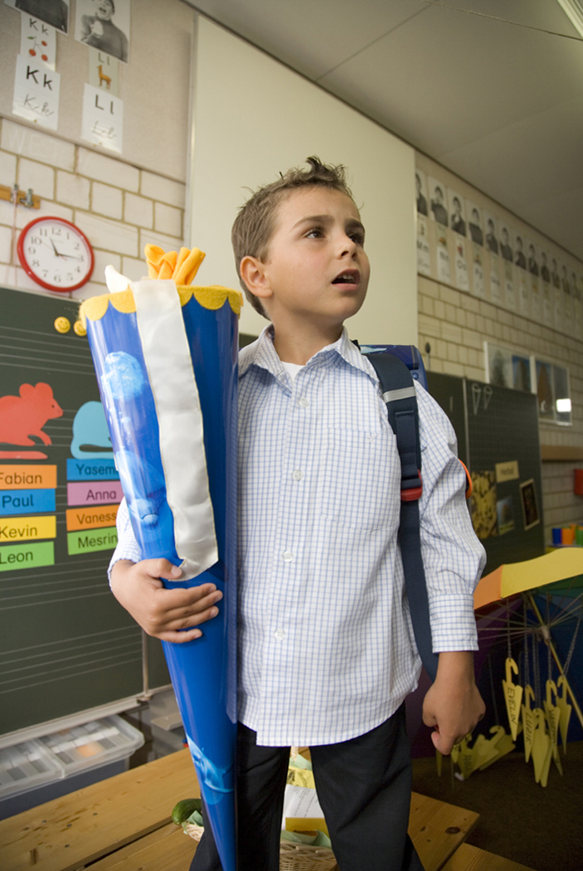




Communication
Page ▪ 19

Slide 20
Class Discussions
Classroom discussions can:
Raise awareness of ideas and strategies.
Teach and practice the difference between respectful debate and intolerant dialogue around issues of difference.
Provide opportunities for students to express their discomfort about witnessing bullying within the safety of a classroom discussion.
Help students realize that they are not alone in their wish for bullying behaviors to stop.
Provide a great opportunity for students to brainstorm possible solutions to common bullying situations.
Page ▪ 20
Citations ▪ 5, 12
Notes:
Citation (5, 12)

Slide 21
Positive Classroom Management
Teachers who employ positive classroom management:
Emphasize what students should do rather than what they should not do.
Reinforce rules as a role model who follows them.
Use one-on-one feedback, and avoid public reprimands.
Show students respect.
Reward good behavior.
Page ▪ 21
Citation ▪ 5
Notes:
Citation (5)

Slide 22
Clear Classroom Ground Rules
Ground rules are most effective when they are:
Tied to both positive and negative consequences
Aligned with schoolwide rules
Developed with student input
Simple and understandable
Posted in the classroom
Fairly enforced
Page ▪ 22
Citation ▪ 5
Notes:
Citation (5)

Slide 23
Sample Anti-Bullying Ground Rules
We will treat others with respect and not bully others.
We will try to help students who are bullied.
We will try to include students who are left out.
If we know that somebody is being bullied, we will tell an adult at school and an adult at home.
Page ▪ 23
Citation ▪ 5
Notes:
Citation (5)

Slide 24
Help Develop Effective Bystanders
Promote an atmosphere of trust and safety in the classroom.
Be a positive adult role model.
Develop strong, positive relationships with students.
Acknowledge that bullying does occur and can be painful.
Intervene and model positive behavior when you see bullying behavior occur.
Provide time for students to learn and practice bystander skills.
Page ▪ 24
Citation ▪ 12

Slide 25
Bystander Intervention Skills
Students can:
Walk away.
Offer support.
Report the incident.
Speak up assertively.
Page ▪ 25
Citations ▪ 5, 8, 12
Notes:
Citations (5, 8, 12)

Slide 26
Supportive Classroom Settings
Engagement: Connectedness, sense of belonging, relationships, respect for diversity, and school participation.
Safety: Freedom from violence, bullying, harassment, and substance abuse. Emotional and physical safety and protection against emergencies.
Environment: Physical, instructional, health and wellness, and disciplinary rules and strategies.
Page ▪ 26
Citation ▪ 10
Notes:
Citation (10)

Slide 27
Engagement
Be a role model by treating all students and colleagues respectfully.
Teach the difference between respectful debate and name calling.
Let students know you’re available to talk.
Have conversations with students about what’s going on in their lives and actively listen.
Encourage positive thinking, and offer positive strategies for dealing with problems.
Have fun! It will make personal connections and help students feel like they belong.
Teach inclusively. Integrate examples of people from different backgrounds every day.
Use inclusive language.
Page ▪ 27
Citations ▪ 1, 5, 12
Notes:
Citations (1, 5, 12)

Slide 28
Safety
Remind participants of the importance of providing clear expectations and fair, consistent responses to violations as foundational elements to creating a positive environment.
Step in during problematic situations, actively using your power to identify concerns and offer solutions.
Make a safe, bully-free culture the “norm.”
Encourage students to do what they love. Special activities can boost confidence, help youth make friends, and protect them from bullying behavior.
Make time for daily conversations with students about their lives and feelings.
Ask a variety of questions when you talk with students.
Talk about bullying. If concerns come up, be sure to respond.
Read and learn about bullying.
Create supportive ground rules for your classroom.
Be positive—tell students what to do, not just what not to do.
Teach positive relationship skills.
Page ▪ 28
Citations ▪ 1, 5, 12
Notes:
Citations (1, 5, 12)

Slide 29
Environment
Weave positive behaviors into daily interactions with students and colleagues.
Set a positive tone in your classroom.
Demonstrate appropriate boundaries and expectations for positive relationships.
Examine your own beliefs, and examine your own assumptions, biases, or stereotypes.
Work directly both with students who are being bullied and students who are bullying others.
Establish a culture of respect for difference.
Talk about differences in respectful and informative ways.
Work with parents and youth to send a unified message against bullying.
Page ▪ 29
Citations ▪ 1, 5, 12
Notes:
Citations (1, 5, 12)

Slide 30
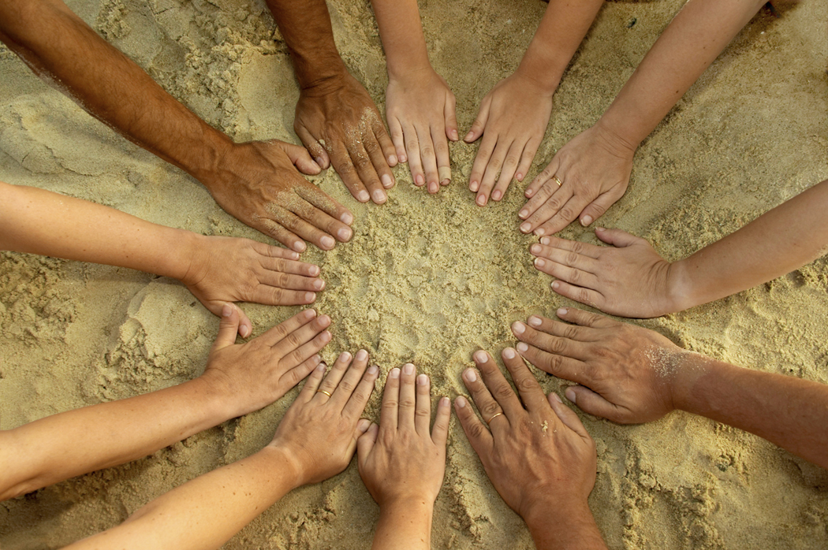
Building a Web of Support
Page ▪ 30

Slide 31
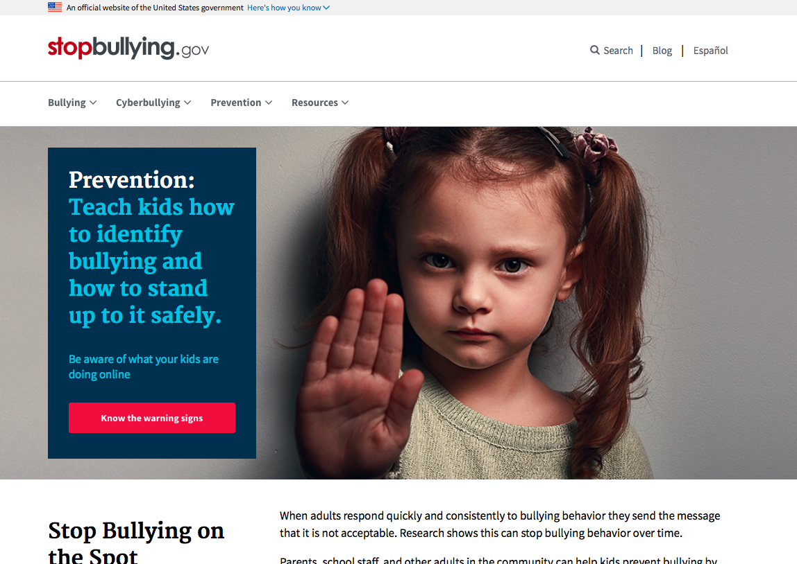
Additional Support
Page ▪ 31

Slide 32
A Legacy
Children are living messages we send to a time we will not see.
John W. Whiteland
The Stealing of America, 1983
Thanks for Participating!
Page ▪ 32
Notes:
Citation (13)

