Slide 1

Module 1:
Building Resilience in the Face of Stress
Building Student Resilience Toolkit

Slide 2
Modules in This Series
Module 1: Building Resilience in the Face of Stress
Module 2: Building Resilience in the Classroom
Module 3: Self-Care Guide for All Staff
Module 4: Resilience Resource Guide for Administrators
This workshop is a product of the National Center on Safe Supportive Learning Environments, under funding provided by the U.S. Department of Education. For more information, visit http://safesupportivelearning.ed.gov.

Slide 3
Jayden’s Story
Jayden wants to learn.
But Jayden is stressed. He is worried about taking tests, making friends, and being bullied at school and about his parents’ arguing at home.
He shows many signs of stress.
Jayden would benefit from being more resilient.
Much of what helps Jayden will help all your students build resilience.
Many of the same concepts, issues, actions, and needs are also relevant to your life and other adult staff at your school.

Slide 4
Objectives for Module 1
After completing this module, participants will be able to
Explain the definition of resilience,
Differentiate between stress that is necessary for growth and stress that is damaging and toxic,
Acknowledge the effects of trauma, and
Articulate four factors that promote student resilience.

Slide 5
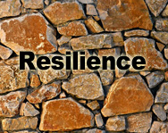
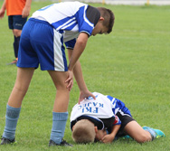
Definition of Resilience
Resilience is a positive, adaptive response to adversity and other sources of stress.
Resilience is not a trait that’s set in stone.
Resilience is a quality that should be cultivated—like strength, courage, or kindness.
Citations 1 and 2

Slide 6
Categories of Stress
Type of Stress | Effects | Sensations
Positive Stress | Briefly increases heart rate Slightly elevates adrenaline and other stress hormones | Excitement
Tolerable Stress | Elevates stress hormones to a greater degree Calls for substantial adult support | Fear Grief
Toxic Stress | Excessive or prolonged activation of stress hormones Disrupts brain function | Terror Hopelessness Negative expectations
Positive
Stress
Tolerable
Stress
Toxic
Stress
Citation 3

Slide 7
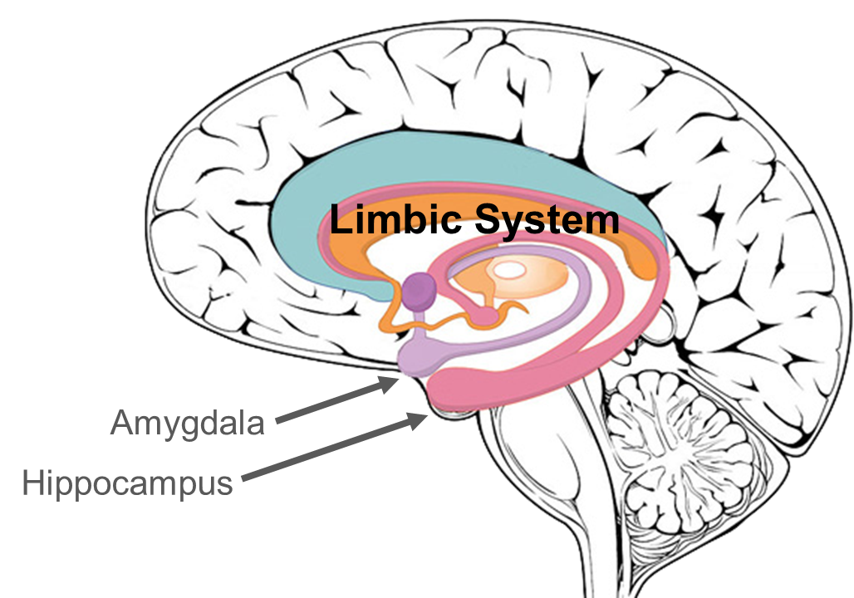
Stress and the Brain
Citations 2 and 3

Slide 8
Definition of Trauma
Trauma is the result of “an event, a series of events, or a set of circumstances that is experienced by an individual as physically or emotionally harmful or life threatening and has lasting adverse effects on the individual’s functioning and mental, physical, social, emotional, or spiritual well-being.”
            —Substance Abuse and Mental Health Services Administration (SAMHSA) (2019, August 2)
Citation 4

Slide 9
Adverse Childhood Experiences (ACEs) Categories
Abuse | Household Dysfunction | Neglect
Emotional | Mother is treated violently | Emotional
Physical | Household substance abuse | Physical
Sexual | Mental illness
 | Parental separation or divorce
8 possible ACEs | 9 possible ACEs | 2 possible ACEs
Citation 5

Slide 10
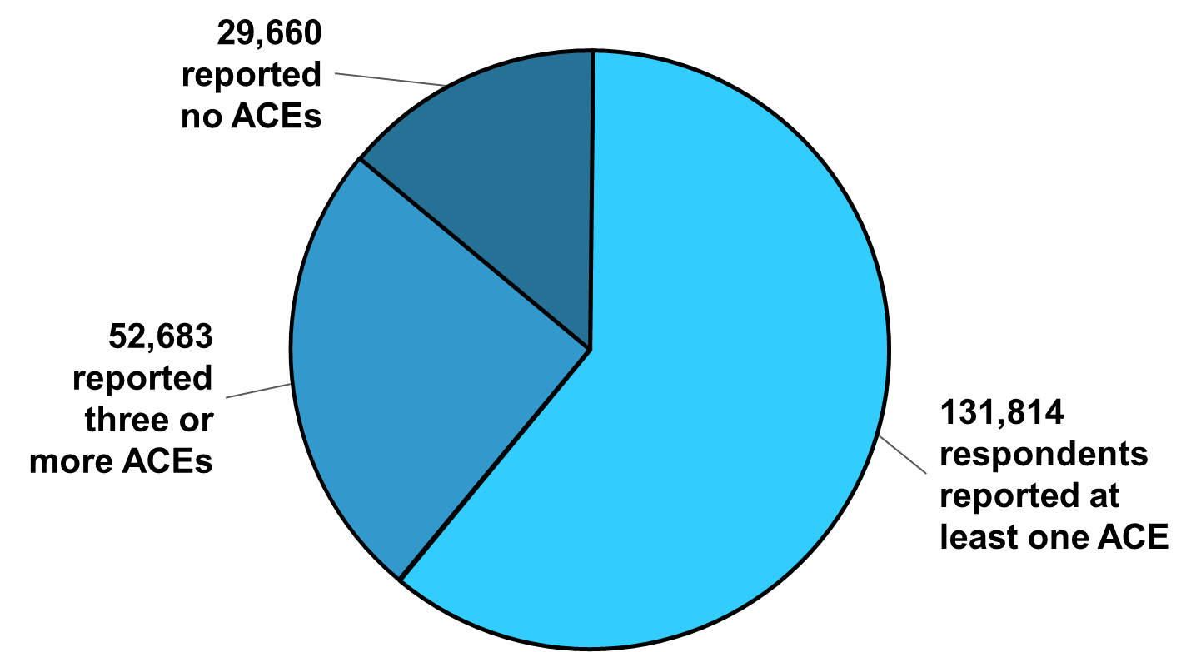
Prevalence of ACEs Among 214,157 Respondents
Citation 6

Slide 11
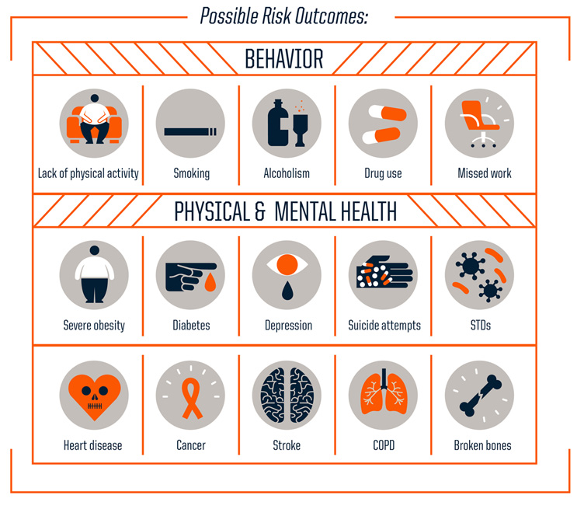
Risks from ACEs
Citation 7

Slide 12
National Stressful Events Survey
Event Type | Number | %
Disaster | 1,491 | 50.5
Accident/fire | 1,427 | 48.3
Exposure to hazardous chemicals | 493 | 16.7
Combat or warzone exposure | 231 | 7.8
Physical or sexual assault | 1,568 | 53.1
Witnessed physical/sexual assault | 982 | 33.2
Witnessed dead bodies/parts unexpectedly | 667 | 22.6
Threat or injury to family or close friend due to violence/accident/disaster | 956 | 32.4
Death of family/close friend due to violence/accident/disaster | 1,529 | 51.8
Citation 8

Slide 13
Sources of Student Stress
School
Abuse at home or from being bullied
Family relationships
Romantic relationships
Friends
Hormonal changes
Puberty developments
Worries about climate change
Pressures to conform
Pressure to take dangerous risks
Problems at home
Dangerous neighborhoods
Trauma
Health problems
Mental health concerns
Decisions about the future
Global issues
Fear of failure
Citation 6

Slide 14

Effects of Student Stress
Anxiety, fear, and worry
Withdrawal, numbness
Physical complaints
Change in academic performance, inattention
Over- or under-reacting to bells, physical contact, doors slamming, sirens, lighting, sudden movements
Resistance to authority
Disruptive, aggressive, or angry behavior
Experimentation with risky behaviors
Citations 9 and 10

Slide 15
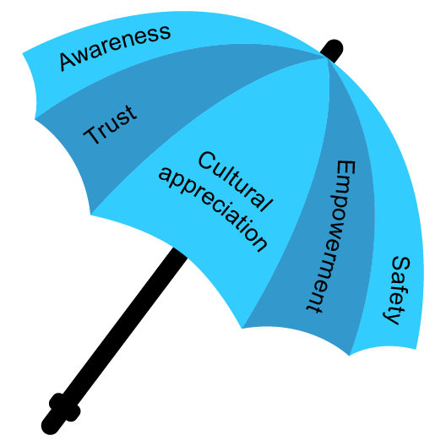
Umbrella of Safety
Citation 11

Slide 16

Resilience
An adolescent who is resilient is likely to enter adulthood with a good chance of coping well—even if he or she has experienced difficult circumstances in life.
Citations 13, 14, and 15

Slide 17
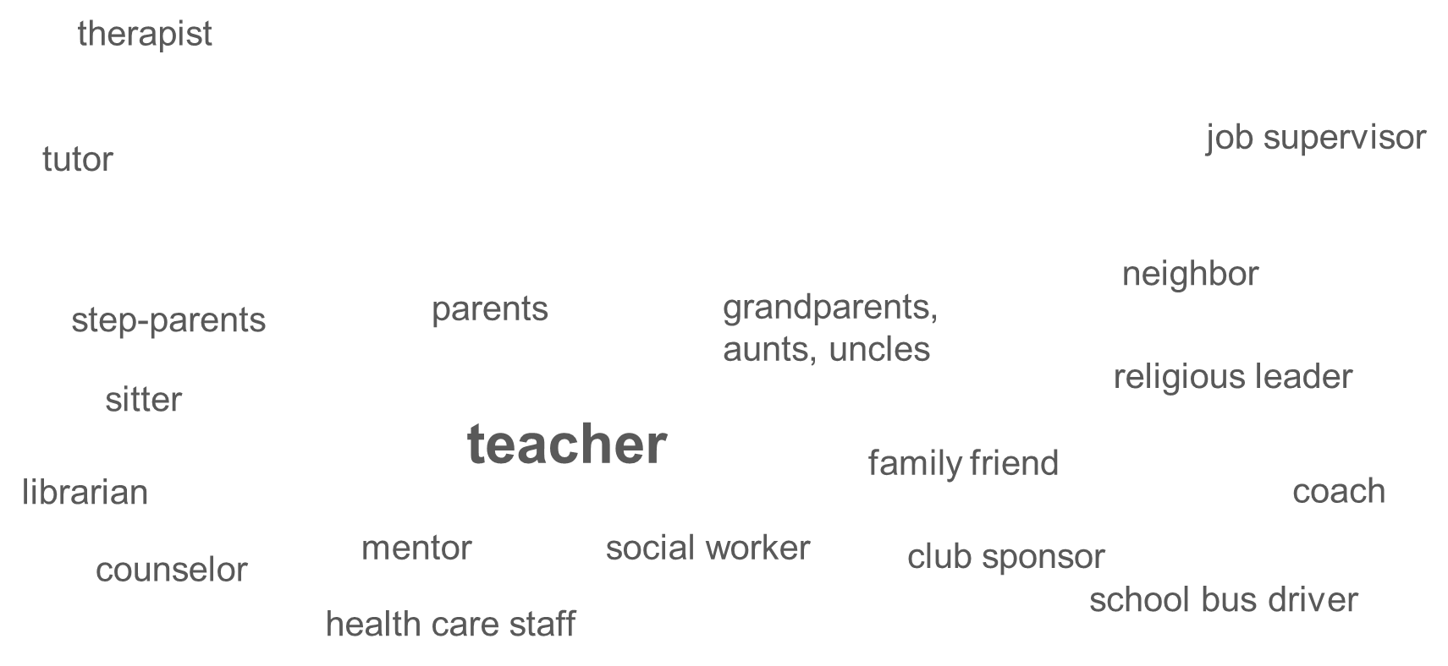
Factor 1: Positive Adult Relationships
The single most common factor for children developing resilience is having at least one stable, caring, and supportive relationship with an adult.
Citations 1, 14, and 16

Slide 18
Teacher–Student Relationship
How you (as the educator) make sure that students feel safe,
How you set up a predictable environment,
How you establish and enforce boundaries,
How you institute fair and consistent classroom practices and standards of conduct, and
How you apply discipline in ways that avoid shame and encourage appropriate behavior.
Citation 17

Slide 19
It Meant More Than I Imagined
Who knew?
Think of a time when something you said or did seemed to make a difference to a student.
Summarize the encounter on the index card.
Include the student’s response.
Speculate on the reason it seemed to matter to the student.
Do not include your name on the index card.
Pass your cards to me.

Slide 20
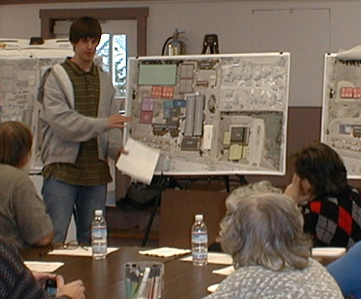
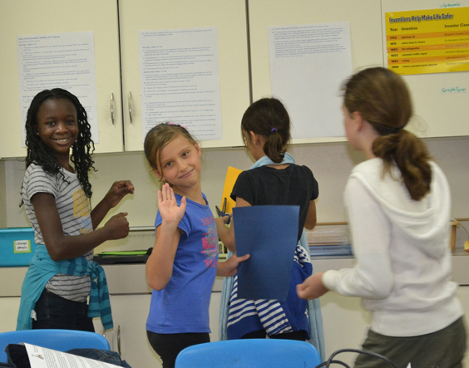
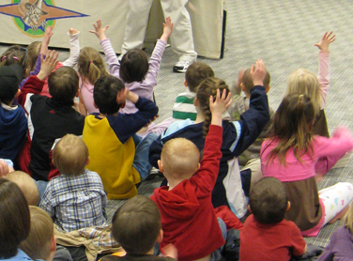
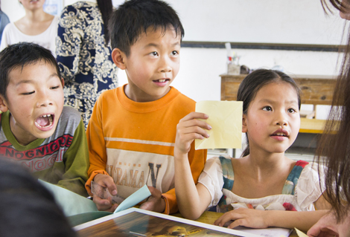
Factor 2: Empowerment
Voice and Choice
Citation 9

Slide 21
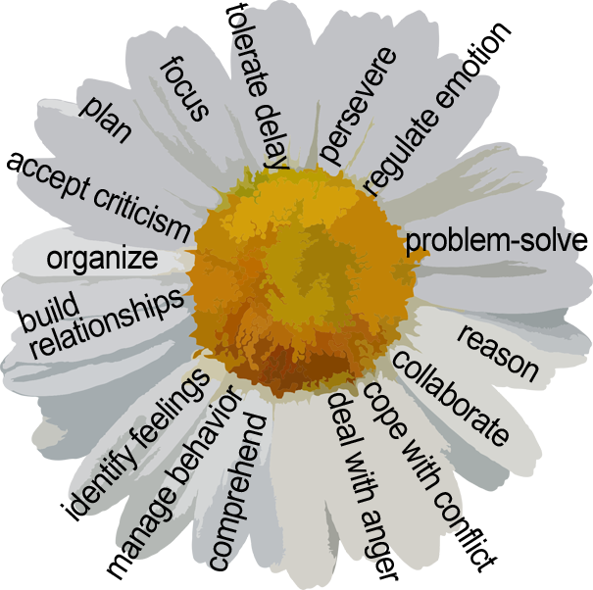
Factor 3: Adaptive Skills
Citation 1

Slide 22
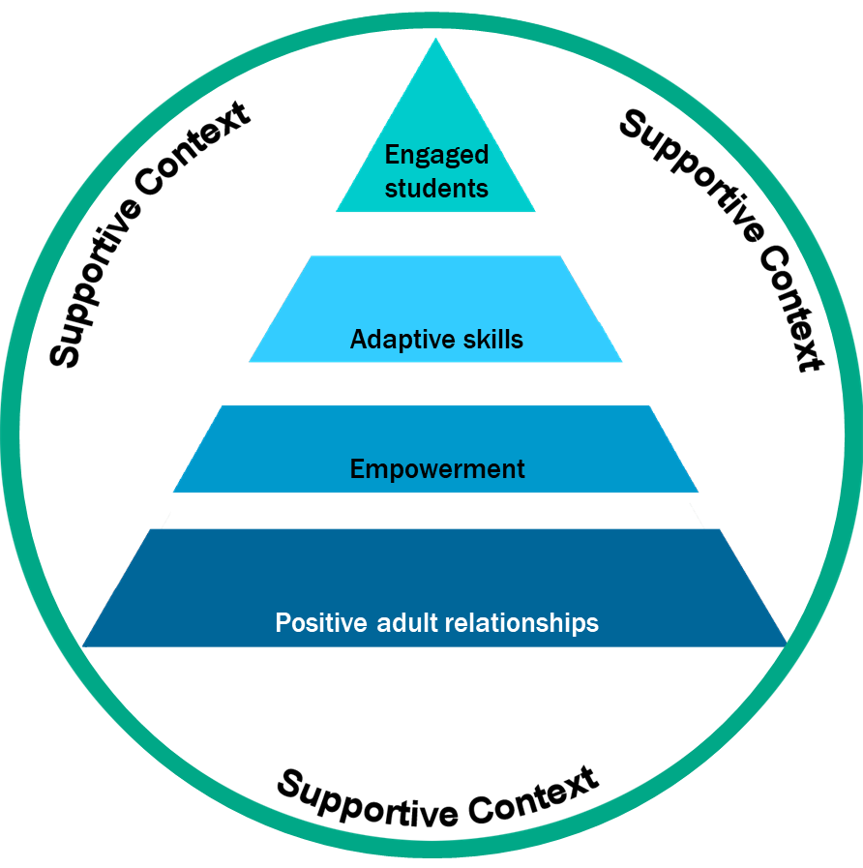
Factor 4: Supportive Context
Citation 1

Slide 23
What’s Next?
Module 1: Building Resilience in the Face of Stress
Module 2: Building Resilience in the Classroom
Module 3: Self-Care Guide for All Staff
Module 4: Resilience Resource Guide for Administrators

