Slide 1
Module 2:
Building Resilience in the Classroom

Slide 2
Modules in This Series
Module 1: Building Resilience in the Face of Stress
Module 2: Building Resilience in the Classroom
Module 3: Self-Care Guide for All Staff
Module 4: Resilience Resource Guide for Administrators
This workshop is a product of the National Center on Safe Supportive Learning Environments, under funding provided by the U.S. Department of Education. For more information, visit http://safesupportivelearning.ed.gov.

Slide 3
Activity 1: The Best Work Situation Ever
What are the ideal qualities of your relationships with colleagues and administrators?
How do colleagues and administrators treat you? How do you treat them?
Describe the physical and emotional aspects in your ideal work situation that would promote a feeling of safety.
To what extent are there opportunities to deepen and broaden your work skills?
What opportunities do you have to contribute to what happens in your school?

Slide 4
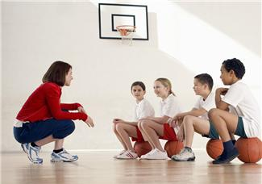
Resilience Factors
Positive relationships
Empowerment
Adaptive skills
Supportive context
Citation 1

Slide 5
Objectives for Module 2
After completing this module, participants will be able to
Associate aspects of a positive classroom climate with factors that boost resilience,
Describe how building resilience helps students learn to cope with stress and trauma,
Select strategies to build resilience in the classroom, and
Identify strategies you may be using already that help students build resilience.

Slide 6
Definition of Resilience
  Resilience is a positive, adaptive response to adversity and other sources of stress.
Resilience is not a trait that’s set in stone.
Resilience is a quality to be cultivated—like strength, courage, or kindness.
Citations 1 and 2

Slide 7
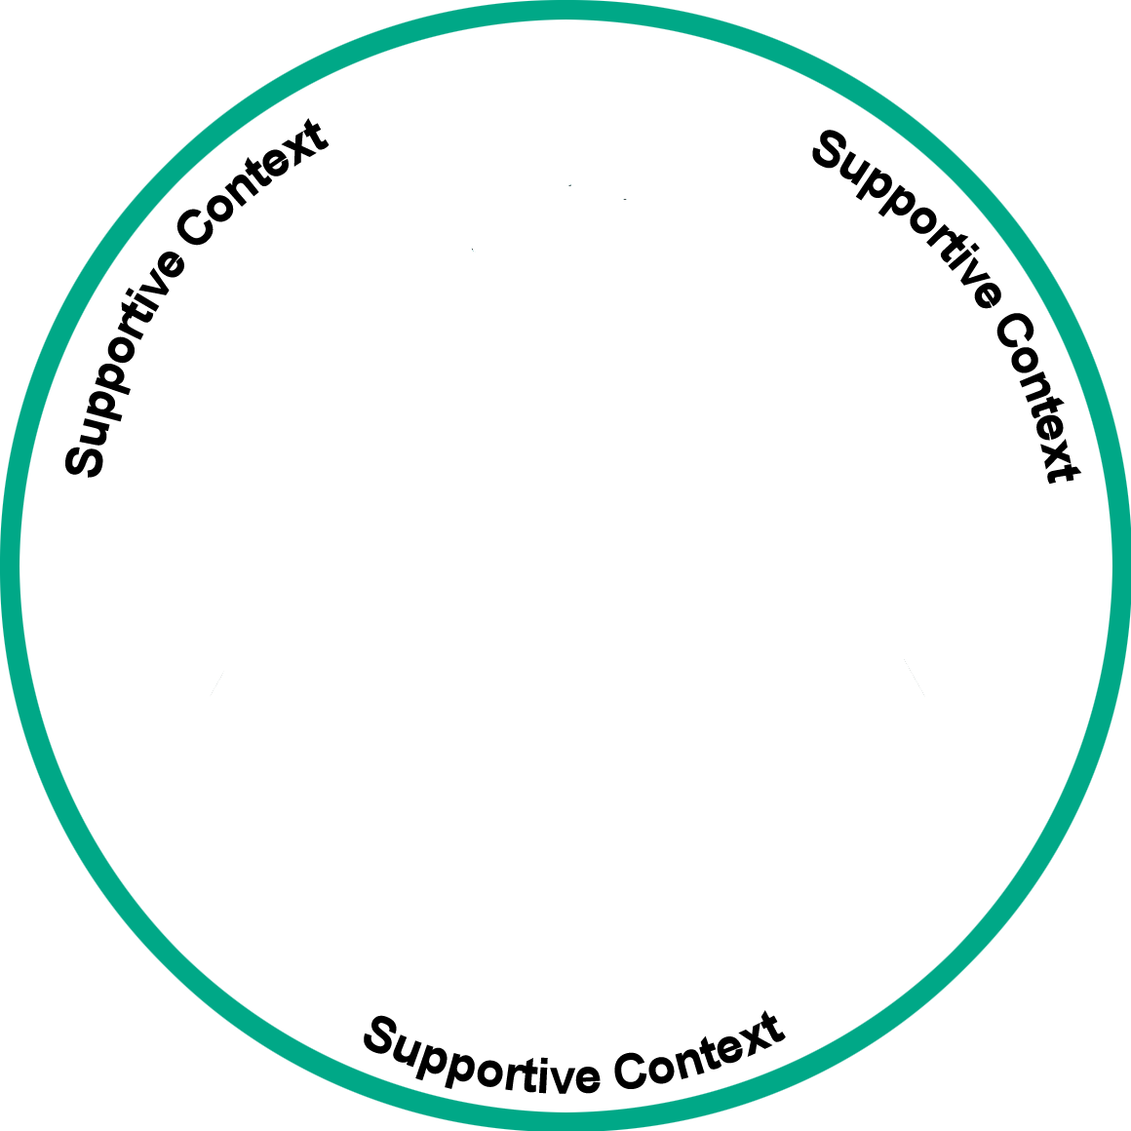

Resilience Building
Engaged students
Adaptive skills
Empowerment
Positive adult relationships
Citation 1

Slide 8
Factor 1: Positive Adult Relationships
The single most common factor for children who develop resilience is having at least one stable, caring, and supportive relationship with an adult.
Citations 3, 4, and 5

Slide 9
The Impact of Positive Relationships
Students are more likely to come to school because they feel more connected to you.
This means they do better in school—better grades, higher test scores, and more likely to graduate.
They learn to make better choices.
Students are less likely to get in trouble or have problems.
They work harder and spend more time on homework.
Students develop confidence.
Citation 6

Slide 10
Important Things That Teachers Do
Students say it’s about
How you teach, not what you teach;
Making everyone feel safe;
Establishing a predictable environment; and
Treating everyone fairly and consistently.
Citation 7

Slide 11
Create a Place of Safety
Establish a predictable environment.
Treat each student fairly and consistently.
Demonstrate respect for others.
Encourage students to take individually appropriate risks for growth.

Slide 12
Be Available
Invite positive relationships.
Be accessible.
Check in on how students are doing.
Notice more than academic performance.
Take a personal interest.
Citation 7

Slide 13
Listen
Treat all students fairly.
Actively listen to concerns and worries.
Engage students in conversations about their lives.
Ask for clarification.
Demonstrate your understanding of students’ needs.
Exhibit respect and empathy.
Citation 7

Slide 14
Be Positive
Encourage and model positive thinking.
Let students know you believe in them.
Talk about ways to overcome barriers and challenges.
Have fun.
Citation 7

Slide 15
Set High Expectations
Acknowledge challenges students face but hold them to high standards.
Identify their gifts and talents.
Encourage, challenge, and inspire students.
Work with students to set their own meaningful goals.
Notice their hard work.
Acknowledge their accomplishments.
Celebrate milestones.
Citation 2

Slide 16
Be Real
Be comfortable with yourself.
Share personal information when appropriate.
Look for opportunities to use a sense of humor.
Admit your mistakes.
Apologize when situations warrant.
Citation 7

Slide 17
Factor 2: Empowerment
Empowerment is the process of becoming stronger and more confident, especially in controlling one’s own life.
Find indicators of student strengths.
Mirror those strengths back to students.
Encourage and reinforce student strengths.
Provide opportunities for strengths to flourish.
Teach students how to use their strengths to cope and thrive.
Citations 1 and 8

Slide 18
Activity 2: Pair & Share to Identify Strengths
Examples of personal strengths:
Enjoys new experiences
Creative
Thoughtful
Good storyteller
Speaks up
Sees things a little differently
Citation 7

Slide 19
Factor 3: Adaptive Skills—Relationships
You can help students practice relationships by
Modeling positive, caring relationships,
Discussing what goes into relationships,
Providing opportunities to practice getting along; and
Encouraging students to cooperatively work, talk, and learn together.
Citations 1, 9, and 10

Slide 20
Adaptive Skills: Goals and Planning
Students need to practice setting goals, developing plans, and making decisions. With your help, students can learn to
Set realistic and achievable goals,
Think through and develop a plan to achieve a goal,
Make decisions,
Ask for help, and
Cope with failure and disappointment.
Citations 1, 9, and 10

Slide 21
Adaptive Skills: Identify Feelings
Students need to practice identifying feelings and managing behaviors.
You can help students by:
Asking questions of them and reflecting back what you see and hear,
Offering opportunities to practice appropriate behavioral responses, and
Practicing strategies for coping effectively with discomfort and difficult circumstances.
Citation 11

Slide 22
Adaptive Skills: Meaningful Participation
Students need daily opportunities to practice voice and choice. You can do this by
Seeing students as participants and partners, not just as recipients or consumers;
Engaging students in the development of a class vision and code of conduct;
Discussing and posting daily schedules and tasks;
Assigning classroom tasks to students; and
Regularly involving students in classroom discussions and meetings.
Citations 10 and 12

Slide 23
Factor 4: Supportive Context
Important cultural traditions are affirmed in the following contexts:
Caring families with routines and rituals,
Supportive organizations outside the family, and
Connections with well-functioning communities.
Citations 1 and 13

Slide 24
Well-Functioning Schools
Engagement in a well-functioning school includes
Learning about cultural traditions among your students;
Accepting and cherishing the full range of diversity in your classroom;
Viewing diversity as a strength;
Engaging all students in an inclusive environment; and
Modeling, teaching, and expecting respectful conduct.
Citations 2, 11, and 14

Slide 25
Activity 3: Pair & Share to Identify Existing Strategies
Building resilience complements other approaches, such as
Social emotional learning (SEL),
Positive Behavioral Interventions and Supports (PBIS) or other multitiered systems of support,
Trauma-sensitive practices,
Restorative practices, and
Positive school climate.
Citation 2

Slide 26
Other Modules in This Series
Module 1: Building Resilience in the Face of Stress
Module 2: Building Resilience in the Classroom
Module 3: Self-Care Guide for All Staff
Module 4: Resilience Resource Guide for Administrators

