Slide 1
Welcome Project Prevent Grantees

Slide 2
Welcome from the Office of Safe and Healthy Students
David Esquith

Slide 3
Welcome to the Project Prevent Grantee Session: Inspire. Create. Sustain.
Nicole White, ED; Sandy Williamson, NCSSLE

Slide 4
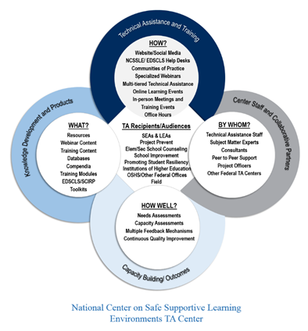
Nuts and Bolts of NCSSLE
Technical Assistance and Training
Center Staff and Collaborative Partners
Capacity Building Outcomes
Knowledge Development and Products
TA Recipients and Audiences
Notes:
Sandy

Slide 5

P2 Grantees Progress and Journey
Notes:
Sandy

Slide 6
Agenda
1
Into the Future (Stephanie Autumn, TAS, NCSSLE)
2
Critical Issues Roundtables (Kathleen Guarino, TAS, NCSSLE)
3
Break (10 minutes)
4
Strategies for Sustainability: Addressing Factors YOU Can Control (Jeanne Poduska, TAS, NCSSLE)
5
GPRA Performance Measures (Nicole White, ED)
6
Action Planning for School Year 2016-2017 (NCSSLE TAS)
7
Closing (Sandy Williamson, NCSSLE; Nicole White, ED)
Inspire. Create. Sustain.

Slide 7
Into the Future
Facilitor: Stephanie Autumn, NCSSLE, AIR
Notes:
7

Slide 8

Project Prevent
“Into the Future”
Visioning
Creativity
Inspiration
Learning
Reflection
Sharing
Inspire. Create. Sustain.

Slide 9
Critical Issues Roundtable
Facilitor: Kathleen Guarino, NCSSLE, AIR
Notes:
9

Slide 10
Project Prevent
A vision without a plan is just a dream.
A plan without a vision is just drudgery.
But a vision with a plan can change the world.
(World Resources Institute (WRI), 2000)
Inspire. Create. Sustain.

Slide 11
Project Prevent
“What’s keeping you up at night?”
Where do we need to focus our efforts in the coming year to grow and sustain our vision and goals?
Inspire. Create. Sustain.

Slide 12
Roundtable Topics
Choose a topic below that aligns with your primary concerns/needs for the coming year.
1
Communication: Telling your story
2
Mental Health: Screening and assessment
3
Grant Management: Staffing, buy-in, tracking progress
4
Implementation: Fidelity, monitoring, engagement
Page ▪ 12
Inspire. Create. Sustain.

Slide 13
Roundtable Topics
Discussion Questions:
What is important about this topic for you?
What would success look like at the end of SY17?
What would success look like at the end of the grant?
What would support look like for you?
Page ▪ 13
Inspire. Create. Sustain.

Slide 14
Strategies for Sustainability: Addressing Factors YOU Can Control
OSHS Project Director Training - Grantee Session
Presenters: Jeanne Poduska, NCSSLE
Notes:
14

Slide 15
Session Flow
1
A few thoughts on sustainability and sustainabilty planning.
2
Grantees share experiences and wisdom.
Inspire. Create. Sustain.

Slide 16
Where Are You in Planning for Sustainability?
We have a fully developed sustainability plan.
We have started a sustainability plan; it needs further development.
We are at the initial stage of developing a sustainability plan.
We have not yet begun developing a sustainability plan.
Inspire. Create. Sustain.
Notes:
15 minutes

Slide 17
Some Thoughts on Sustainability
Introduction of any new program or practice requires change: staff, training, materials.
P2 grant funds will end.
A step in sustainability planning is to specify the functions and requirements for P2 programming and practices.
Develop a sustainability plan.
  “Planning for Sustainability Online Learning Event” https://safesupportivelearning.ed.gov/events/webinar/planning-sustainability
Inspire. Create. Sustain.
Notes:
15 minutes

Slide 18
A Few More Thoughts on Sustainability
Our work is embedded within systems.
Two key factors associated with successful sustainability:
        Secure Community Support
        Integrate Program Services into Local Infrastructures
Stakeholders and partners.
Inspire. Create. Sustain.
Notes:
15 minutes

Slide 19
Sharing Experiences and Wisdom: Whole Group Activity
1) Choose a slip of paper.
2) Read the question aloud to the group.
3) Everyone thinks silently about the question for 30 seconds.
4) The person who selected the question can choose to answer it…
OR
5) Can offer the question to the group and someone else can answer it.
Inspire. Create. Sustain.
Notes:
15 minutes

Slide 20
Project Prevent GPRA Submissions
OSHS Project Director Training - Grantee Session
Nicole White, ED
Notes:
20

Slide 21
Action Planning
OSHS Project Director Training - Grantee Session
Facilitators: Katie Deal, P2 TA Team, NCSSLE

Slide 22
Project Prevent
“What’s keeping you up at night?”
Where do we need to focus our efforts in the coming year to grow and sustain our vision and goals?
Inspire. Create. Sustain.

Slide 23
Roundtable Topics
Questions for Reflection:
What potential priorities and action items came up for you during previous sessions today (e.g. Critical Issues Roundtable, Sustainability)?
What areas of the “Grant Sustainability Tool” handout are most relevant to your project right now?
How do your action steps connect to the outputs and outcomes in your logic model?
Inspire. Create. Sustain.

Slide 24
Notable NCSSLE Resources
Brand NEW!
School Climate Improvement Resource Package
Safe Place to Learn: Prevent, Intercede, and Respond to Sexual Harassment of K-12 Students
Other Resources
Addressing the Root Causes of Disparities in School Discipline: An Educator’s Action Planning Guide
Creating a Safe and Respectful Environment on Our Nation's School Buses
Creating a Safe and Respectful Environment in Our Nation’s Classrooms
Get Smart, Get Help, Get Safe: Preventing, Assessing, and Intervening in Teenage Dating Abuse - A Training for Specialized Instructional Support Personnel
Inspire. Create. Sustain.

Slide 25
Contact
Nicole White
Project Prevent Program Officer
nicole.white@ed.gov
Inspire. Create. Sustain.

Slide 26
Closing
OSHS Project Director Training - Grantee Session

Slide 27
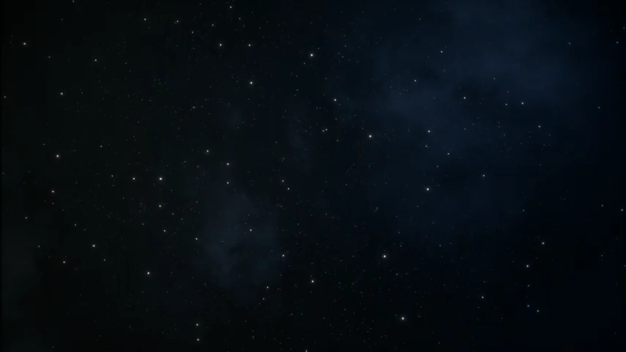
TED Talk: Every Kid Needs a Champion by Rita Pierson
Rita Pierson, a teacher for 40 years, once heard a colleague say, "They don't pay me to like the kids." Her response: "Kids don't learn from people they don't like.'" A rousing call to educators to believe in their students and actually connect with them on a real, human, personal level.
Inspire. Create. Sustain.

Slide 28
Thank you for your
active participation!!
Inspire. Create. Sustain.

