Slide 1
Welcome to Today’s Supportive School Discipline Webinar Series Event! At the Intersection of School Safety and Supportive Discipline: Navigating the Roles and Responsibilities of School Resource Officers
1
This event will start at 4:00 p.m. E.T.

Slide 2
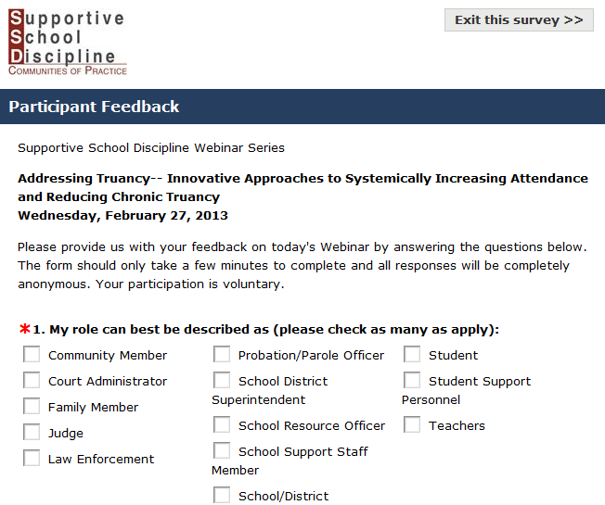
Q&A
Feedback Form
If you have a question for the presenters, please type it in the Q&A Pod or email ncssle@air.org during the Webinar.
At the end of the presentation, an event feedback form will appear. Please provide feedback on this event so that we can better provide the resources that you need. All answers are completely anonymous and are not visible to other participants.
For assistance during the Webinar, please contact
the National Center on Safe Supportive Learning Environments
at ncssle@air.org.

Slide 3
Federal Partners Welcome
Linda Rosen
Member, Supportive School Discipline Working Group
State Representative, U.S. Department of Justice, Office of Juvenile Justice and Delinquency Prevention.

Slide 4
SSD Webinar Series
4
Increase awareness and understanding of school disciplinary practices that push youth out of school and many times into the justice system.
Provide practical examples of alternative approaches that maintain school safety while ensuring academic engagement and success for all students.

Slide 5
Available Technical Assistance
Office of Juvenile Justice and Delinquency Prevention’s State Training and Technical Assistance Center (STTAC)
U.S Department of Justice www.juvenilejustice-tta.org
Supportive School Discipline Communities of Practice (SSDCOP)
U.S. Department of Education http://ssdcop.neglected-delinquent.org
National Center on Safe Supportive Learning Environments (NCSSLE)
U.S. Departments of Education and Health and Human Services http://safesupportivelearning.ed.gov

Slide 6
Polling Question #1
Which of the following best describes your role?
School/district administrator
School/student support staff
Teacher
School resource officer
Probation/parole officer
Law enforcement
Judge or court administrator
Family member
Youth
Community stakeholders
Researcher
Advocate

Slide 7
Polling Question #2
Which of the following best describes the primary reason you chose to participate in today’s session?
Need a refresher
Hear the latest research
Hear examples of how other communities are taking positive approaches to discipline

Slide 8
Agenda
8
1
Rochester, NY: A Local Examplar of SRO-School Community Collaboration Moses E. Robinson, School Resource Officer, Rochester Police Department. Alecia Zipp-Mclaughlin, Program Administrator, East School, Rochester New York.
2
An Overview of the Evolving Roles of SROs, the NASRO Model, and MOUs Mo Canady, Executive Director, National Association of School Resource Officers (NASRO).
3
Policing the Teen Brain in Public Schools: Key Factors to Consider Lisa H. Thurau, J.D., Founder, Strategies for Youth
Notes:
An Overview of the Evolving Roles of SROs, the NASRO Model, and MOUs Mo Canady, Executive Director, National Association of School Resource Officers.

Slide 9
A Local Examplar of SRO-School Community Collaboration
9
Officer Moses E. Robinsob
School Resource Officer Rochester Police Department
Alecia Zipp-Mclaughlin
Administrator, East High School
Rochester, New York

Slide 10
School Resource Officer’s Mission Statement
10
School Resource Officers are a group of highly trained members of the Rochester Police Department whose focus is delivery of effective and responsive law enforcement service concentrated on the prevention of youth related crime and reduction of youth violence.

Slide 11
School Resource Officer’s Vision and Goal
11
To promote a safe learning environment for our students and staff, while building relationships by enhancing communication through positive interaction. We will provide educational understanding of laws as they relate to the community through classroom instruction, thereby cultivating good citizenship and respect for people and property.

Slide 12
12
NASRO: School Resource Officer Triad Concept
LAW Enforcement
Counselor
TEACHER

Slide 13
Citation  1
13
Role of School Resource Officers
A classroom resource for instruction in the following areas: law related education, violence diffusion, safety programs, alcohol and drug prevention, crime prevention, and other areas.
A resource to parents, teachers and students for informal counseling conferences on an individual basis, dealing with individual problems or questions.
A visible, active law enforcement figure on campus that can assist in dealing with any law enforcement issues.

Slide 14
Rochester Police Department School Resource Officer Program
14

Slide 15
15
Rochester Police Department School Resource Officer Program
Rochester Police Department’s SRO program was established in September 1995.
15 officers were selected into the program in the fall of 1995.
SROs were assigned to the newly formed Youth Services Section of the RPD which focuses on truancy, gang prevention, warrant activities and juvenile delinquency.
Currently there are 11 SROs under the supervision of one Sargent.
9 SROs are assigned to local area high schools, 2 SROs are assigned to youth related incidents such as truancy and juvenile warrants.

Slide 16
SRO Training for RPD
16
COPS Program
Roles and responsibilities of SROs
Mentoring & Problem Solving
NASRO
Basic SRO Training
Advanced SRO Training
SRO Supervision & Management
Combating Gangs & Bullying
Fox Valley College
Protecting Children Through Prevention & Response
Technology Training & Risks for Youth
Child Protection Services

Slide 17
RCSD Demographics
17
32,000 students in pre-K through grade 12
64% African American/Black
22% Hispanic
11% White
3% Asian/Native American/East Indian/Other
88% Free and Reduced Lunch
18% SPED
10% LEP
22% of schools at 90% poverty or higher

Slide 18
Stakeholder & Interagency Communication, Coordination & Cooperation = Collaboration
Citation  1
18
The collaboration between school officials and school resource officers is an effective component in preserving the rights of boys and girls to attend schools that are safe, secure and peaceful.
Notes:
Law enforcement's specialized knowledge of the law, local and national crime trends and safety threats, people and places in the community, and the local juvenile-justice system combine to make them critical members of schools' policy-making teams when it comes to environmental safety planning and facilities management, school-safety policy, and emergency response preparedness.

Slide 19
Stakeholder & Interagency Coordination, Communication & Cooperation = Collaboration
3 key areas of SRO-School collaboration
Coordinating mental health services/supports
Coordinating supports for youth considered to be at risk
Teaching/Mentoring (especially young men)
Major goals and outcomes
Relationship-building
Student reengagement
Student emotional and physical safety
On-going communication is essential
Daily check-ins and other meetings as needed
Formal planning and reflective debrief meetings
Information gathering from students & community
Notes:
Zipp –
Job Title; EHS’ Administration Team Structure/SLCs
Target list developed in summer based upon attendance, truancy, referrals and low grades
Supporting and responding to high-risk students includes gang prevention

Slide 20
SRO-School Community Collaborations that Support Students with Mental Health Needs
Holistic wraparound services delivery coordination teams
Mental health professionals
Community-based youth support organizations
SROs
School Administration
Notes:
Zipp – Quick description of your Student-School-Home Model

Slide 21
SRO-School Community Collaborations That Support Youth Considered At Risk
Juvenile Justice Prevention Efforts
Formal Behavior contracts
Family Access to Connections Teams (FACTS)
Redirection/Diversion to restorative justice alternatives
Teen Courts
Formal Mediation by trained facilitator
Proactive Gang Prevention
Wraparound Services
Notes:
Moses:
Provide the New York 15/younger violation vs. 16+ arrest/jail/court legal context
Describe when, how and why SROs can or should use their discretion and/or authority by redirected certain situations towards the restorative justice route(s) – BE VERY CAREFUL here by giving a solid example that MOST would agree with.
ZIPP – Share that wraparound services mentioned earlier are also obviously available to at-risk students with mental health needs.

Slide 22
Other SRO Collaborative Roles
Professional Development
Staff Meetings
Leadership Meetings
Notes:
Zipp – Share specific PD topics (classroom mgt., etc.) and situations that would merit Moses’ participation in staff and leadership meetings (i.e. planning, debriefing, etc.) as needed.

Slide 23
23
Information Sharing and Networking
WORKING TOGETHER FOR THE COMMON GOOD
STUDENTS, STAFF, & SCHOOL
POLICE DEPARTMENT.
SCHOOL RESOURCE OFFICER
CITY SCHOOL DISTRICT
PARENTS
INTERVENTION PROGRAM
CRIMINAL JUSTICE
SERVICES
INTERAGENCY COMMUNITY
COLLABORATION
Let’s work together

Slide 24
24
Lessons Learned:
What Went Well And Why
Essential elements of successful SRO deployment:
The development of positive collaborative relationships between SROs and:
Students
School administration, faculty staff
Families
Community social service agencies
Juvenile Justice and probation

Slide 25
Lessons Learned: What Went Well and Why (cont.)
Collaboratively developed Memorandums of Understanding (MOUs) defining the roles and responsibilities of SROs and required SRO resources/supports.
High quality SRO training targeted to officers’ experience and levels of expertise focused on equipping SROs with the ability to effectively function as a law enforcement officer in educational setting with youth and adolescents in an ethical and prudent manner.
Notes:
RPD-RCSD original partnership concept well articulated in the original MOU
SROs were well received by students & staff.
SROs changed community’s perception of the police.
SROs help to create connections with community partners
Required Resources
Office space
Computers
Basic office supplies

Slide 26
26
Lessons Learned:
What Did Not Go as Planned And Why
High turnover in school administration requires on-going training and awareness-building, roles clarity and collaboration.
Changes in SRO program funding can have negative affects on:
Provision of training opportunities, and
Sustaining high quality SRO programs grounded in clear roles and responsibilities
SRO duties and responsibilities can change from the Triad Concept to one of SROs serving purely disciplinarian and law enforcement roles (i.e. potentially contributing to the school-to-prison pipeline).
Notes:
As to school discipline, the particulars of the essential Memorandum of Understanding between the local law-enforcement agency and school district defines the role the SRO will
play in assisting school personnel with discipline issues that do not involve law violations or threaten campus security. A best practice for discipline issues has emerged nationally over the
past decade and has been endorsed by the courts: an SRO who observes a violation of the school code of conduct, preserves a safe and orderly environment by taking the student(s) to
where school discipline can be determined solely by school officials.
Selective Enforcement
Selective enforcement liability focuses squarely on the failure of educators to implement
campus safety rules fairly.
Victimized students may challenge either a discriminatory policy or the flawed manner in which an evenhanded policy is implemented. In other words, in the
selective enforcement lawsuit, the student accuses the school of indifference or of playing favorites
among the student body such that the disciplinary process creates a bias in favor of
some students and against others.

Slide 27
27
Lessons Learned:
Important Traps to Avoid
Underestimating the importance of annual training and SRO program evaluation.
Being unaware of the overlaps and gaps between law enforcement general orders and state and local discipline policies and procedures, and related potential legal issues, liabilities and civil litigation.
Setting the stage for “selective enforcement” vs. fair and consistent practices
Underestimating the importance of a collaboratively developed MOU, including knowledgeable union representation.
Notes:
Using collaborative tools, today’s safe-schools team avoids the demise that befell their isolated predecessors. Previous educators found themselves stuck in the middle of the
juvenile-justice and child-welfare systems’ efforts to serve and protect children. Without collaboration, these secluded educators accepted the risk of rampages by, and victimization
of, students without any hope of prior notice.
Assault vs. harassment (terminology clarity)
Discipline policy-driven consequences vs. general order-driven legal actions required
Search and seizure protocols
Criminal investigation procedures
Juvenile interview procedures, locations and Miranda rights considerations

Slide 28
Evaluating SRO Programs and Performance
Citation  2
28
COPS’ SRO Performance Evaluation: A Guide for Getting Results provides guidance and tools focused on establishing outcomes-oriented SRO performance evaluation processes that:
Identify the most critical and/or frequent crime and disorder problems that need to be addressed by the SRO.
Assess the SRO’s performance based on results/outcomes rather than activities performed
Provide an opportunity to revise SRO activities if they are not producing the expected results/outcomes.
Notes:
Outcomes - reducing school crime and disorder problems vs. just activities/inputs - how many classroom presentations the SRO conducted.

Slide 29
29
THANK YOU!
Officer Moses Robinson
Rochester Police Department (585) 428-6714 SPECIAL OPERATION DIVISION
(585) 288-3130 EXT 1168 SCHOOL OFFICE
(585) 755-9100 CELL
Email address: moses0928@yahoo.com
Alecia Zipp-Mclaughlin
Administrator, East High School
Rochsester New York

Slide 30
Questions?
?
?
?
If you have a question for the presenters, please type it in the Q&A Pod or email ncssle@air.org during the Webinar.

Slide 31
An Overview of the Evolving Roles of SROs, the NASRO Model, and MOUs
31
Mo Canady
Executive Director
National Association of School Resource Officers (NASRO)
THE World Leader in School Based Policing

Slide 32
History of School Based Law Enforcement
32
The use of police officers in schools has roots dating back to the 1950’s
Timeline
1953 – Flint, Michigan
1963 – Tucson, Arizona
1967 – Cincinnati, Ohio
1968 – Los Angeles
1980’s to Present – Steady increase across the United States.

Slide 33
What Is a School Resource Officer SRO)?
33
Definition
A School Resource Officer is a career law enforcement officer, with sworn authority, deployed in community oriented policing, assigned by the employing police department or agency to work in collaboration with schools.

Slide 34
What is a School Resource Officer (SRO)?
34
A sworn law enforcement officer

Slide 35
What is a School Resource Officer (SRO)?
35
A sworn law enforcement officer.
Properly selected.

Slide 36
36
What is a School Resource Officer (SRO)?
A sworn law enforcement officer.
Properly selected.
Properly trained.

Slide 37
What Is the Role of an SRO?
37
Visible, active law enforcement figure
A classroom resource
A community resource
A “member” of the faculty
Not a replacement for existing school security practices
Not a disciplinarian

Slide 38
Goals of the SRO program
38
Bridge the gap between police officers and young people.
Increase positive attitudes towards law enforcement.
Teach the value of our legal system.
Promote respect for people and property.
Reduce juvenile delinquency by helping students formulate an awareness of rules, authority and justice.

Slide 39
National Association of School Resource Officers (NASRO) Trainings
39
NASRO teaches the SRO Triad concept.
Education
Informal Counselor
Law Enforcement

Slide 40
NASRO Training Courses
Citation  3
40
Basic SRO Course (40 hours)
Roles and Responsibilities of the SRO.
Classroom Management.
Special Education Overview.
Understanding Adolescent Emotional Issues.
The School Safety Team and the role of the SRO.

Slide 41
NASRO Training Courses
Citation  3
41
Advanced SRO Course (24 hours)
Crime Prevention Through Environmental Design
SRO Management (24 hours)
SRO Selection
Interagency Collaboration (MOU)
Evaluation of the SRO
SRO Field Training Officers

Slide 42
NASRO Training Courses
Citation  3
42
SRO Active Shooter (24 hours)
Tactical skills for response to violent attacks
School Law Workshop (8 hours)
Legal updates for the school environment

Slide 43
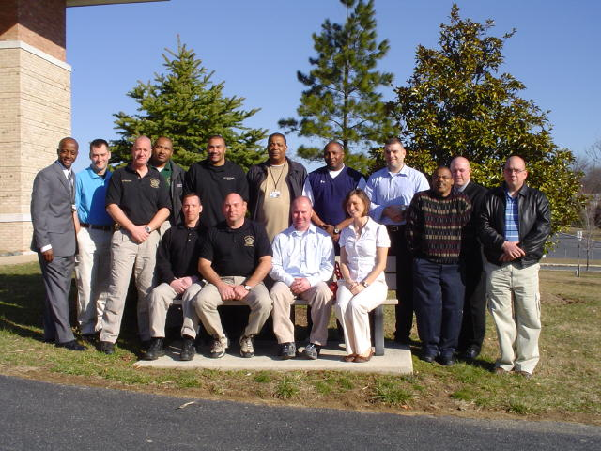
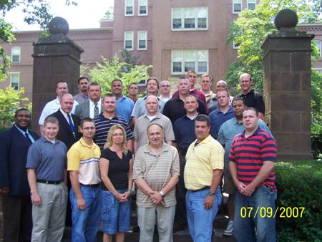
43
A Commitment to Training SROs and School Safety Personnel

Slide 44
Memorandum of Understanding (MOU)
44
Interagency Collaboration is foundational to the success of an SRO program.
The MOU is a written agreement between the school district & the law enforcement agency providing the guidelines for the program.

Slide 45
Elements of a Good MOU
45
Mission Statement
Goals and Objectives
Assignment of SRO
Hours and Special Events
Duties of the SRO
Rights and Duties of the School Board
Access to Education Records

Slide 46
Questions?
?
?
?
If you have a question for the presenters, please type it in the Q&A Pod or email ncssle@air.org during the Webinar.

Slide 47
Policing the Teen Brain in Public Schools: Key Factors to Consider
47
Lisa H. Thurau, J.D.
Founder
Strategies for Youth

Slide 48
48
Strategies for Youth, Inc.
Is a national policy and training organization dedicated to improving police/youth interactions and reducing disproportionate minority contact.
www.strategiesforyouth.org

Slide 49
49
SYF Program Services
Policing the Teen Brain Training
Juvenile Justice Jeopardy Game
Think About it First! Cards
Policy, Advocacy & Research

Slide 50
SFY Training for Law Enforcement
50
WHO:
In-Service training in Police Departments
Training in Recruit Academies
Training for School Resource Officers
WHAT:
Nature
Nurture
Community-Based Options
Youth Perceptions

Slide 51
The School Environment
51
Principal Sets the Tone
Assertion of authority
Bandwidth for Authority Defiance Disorder (ADD)
Police Role
Officer is part of a non LE team
Many interactions daily
Much more diverse population
Many more discretionary calls
Policing is “Public”
Every interaction is a teachable moment
More challenging youth group dynamics; greater consequences
Notes:
In Sync/Opposed to Principal
Depends on deployment

Slide 52
Reality: Diversity of SROs
52
Municipal Police Departments
School Police Departments
Age, race, gender, experience
Differences in Philosophies
School Culture & Context
Notes:
Municipal Police Departments
School Police Departments
Police Department Guidance
Age, race, gender, experience
Training
Differences in Philosophies:
Identifying Misconduct
Responding to Misconduct
Use of Arrest and other
School Culture & Context

Slide 53
Regulators & the Regulated
53
Highly regulated/legal environment
Existing racial & SES biases affect impacts
Oversight & accountability is variable
Notes:
Into this environment, with little planning, we place police.

Slide 54
Factors Affecting Impact of SROs
54
Structural
Skills & Training
Oversight
Accountability

Slide 55
Structural Considerations
55
Regulation of Officer Conduct
Expectations
Deployment
Reporting Obligations
Notes:
Regulation of Officer Conduct
Role Definition: Discipline vs. Offending
Standard Operating Procedures
Oversight
Expectations
What would job evaluation look like?
Education First? Obedience?
Fettering Discretion
Deployment
Reporting Obligations
Deployment varies greatly: from 1 officer for 5 schools, to 1 officer/school; affects ability to build relationships, officers’ reliance on administrators’ characterization of youth conduct; affects teachers/administrators’ ability to rely on officers
Regulation of officer conduct not apparent in that many schools have no MOUs, few Municipal PD have SOP for officers
Expectations not set forth; often only dealt with after perceived breach
Individual SROs are hierarchies where they occupy lowest positions of power below principals/chiefs and are not sure how to resist demands of school officials; in other places not sure how to resist perceptions of the need to arrest

Slide 56
Skills & Training
56
Training of Officers
Developmental Competence
JJ System’s Workings
Youth Chronically Exposed to Trauma
Special Education
Recognition
Response
Law
“R” in SRO
Availability of referrals
What resource does officer provide?
Training with Administrators
Notes:
Little training for officers in how to work with youth, what arrest and referral to jj system offers, recognizing youth with sped issues and appropriate responses

Slide 57
2011 IACP Study of Juvenile Justice In-Service
Citation  4
57
Juvenile Justice
Training Needs Survey of
Chiefs:
No training after recruit academy,
No requirement for in-service training,
No in-service training in juvenile justice for 5 years or > due to lack of funding.

Slide 58
Findings of 2013 SFY Academy Study
Citation  5
58
Average time: 6 hours of training/study
Academy time on JJ: 1%
Topics: Juvenile Code/Law/Rules
Mental Health: 9 hours of training/study
Disproportionate Minority Contact (DMC): 8 hours of training/study

Slide 59
SRO Oversight
Citation  5
59
Structural Determinants
Standard of Review
Frequency of Oversight & by Who?
Oversight in Conjunction with School Goals
Notes:
Structural Determinants
Police Department (reports to school)
School Department (reports to police)
Standard of Review
Terms
Arrests? Contacts?
Youth/Teacher/Administrator Input
Frequency of Oversight & by Who?
Oversight in conjunction with School Goals

Slide 60
SRO Accountability
Citation  5
60
Data Collection
Interview SROs/Administrators/Teachers
Continuing Review & Public Disclosure
Notes:
Data Collection
Contacts
Arrests
Referrals
Interview SROs/Administrators/Teachers
Disproportionate Minority Exclusion
Disproportionate Use of Discipline by Teachers/Administrators
Continuing Review & Public Disclosure

Slide 61
61
Integrating Developmental Competence
into
Police Practice

Slide 62
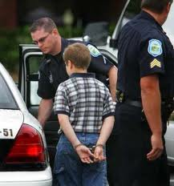
Premise #1
62
Adult criminal justice
system’s approaches
do not work well with
juveniles.
Blowback
Backfires
Notes:
Reduces compliance instead of increasing it, gets a lot of public criticism, not helpful.

Slide 63
SPEAK to the FIST
63
Physical intimidation of youth
Frequent arrests
Zero-tolerance
Impact
Reduces sense of safety among youth and parents
Escalates fear of and reduces interactions with officer
Lessens officers ability to read school climate

Slide 64
Premise #2
64
Officers working with
youth must have basic
developmental
competence to
recognize age-
appropriate behavior &
provide age-appropriate
responses.

Slide 65
Developmental Competence
65
Universal stages of development
Adults & institutions working with children & youth must:
Understand
Apply the Knowledge
Adjust Responses

Slide 66
Premise #3
66
Knowledge of how
the teen brain perceives,
processes, and
reacts is essential for
dealing with youth.

Slide 67
Best Practices for Officers
67
Behavior
Language
Timing

Slide 68
Premise #4
68
Anonymity is an officer’s
enemy:
Relationships with youth are
the most effective approach
to policing youth.

Slide 69
SPEAK to the COACH
69
Accept that it is normal for youth to need to be directed and re-directed--often.
“A coach is someone who can give correction without causing resentment.” John Wooden

Slide 70
Premise #5
70
70
Cross Training,
Partnerships &
Alternatives to Arrest:
Youth-serving adults mutually support/reinforce each other consistently.
Redirect youth to youth-serving organizations.
Use arrest as last resort.
Notes:
Rebuild the village.

Slide 71
Premise #6
71
Everyone on the Same
Page
Juvenile Justice
Jeopardy
Make “rules of the house” clear.
Involve youth in supporting adherence to rules.
Have common understanding and expectations.

Slide 72
Final Thoughts on SRO Role in Supportive Discipline
72
“We must care and give to those in need whether they like us or not.
Ineffective discipline is when we fail to be fair...The focus of
discipline should be on creation of a corrective action plan
rather than punishment for punishment’s sake. The plan should
emphasize training and remediation along with more creative
interventions designed to correct deficits…”
-- Sheriff Lee Baca, Los Angeles Sheriff’s Department Statement on “Education- Based Discipline” for Police Officers.
Notes:
Sheriff Lee Baca, Los Angeles Sheriff’s Department Statement on “Education- Based Discipline” for Police Officers.

Slide 73
73
Final Thoughts on Supportive Discipline
“We must not confuse order with justice.”
--Martin Luther King, Jr.
Letter from Birmingham Jail

Slide 74
Questions?
?
?
?
If you have a question for the presenters, please type it in the Q&A Pod or email ncssle@air.org during the Webinar.

Slide 75
Reminders
We need your help! Please complete the brief feedback form which has just opened up in another window on your computer.
Next SSD Webinars
Youth courts in schools as alternatives to traditional school discipline
Trauma-informed care

Slide 76
Citations
National Association of School Resource Officers. (2013). To Protect and Educate: The School Resource Officer and the Prevention of Violence in Schools. Retrieved from: http://www.nasro.org/sites/default/files/pdf_files/NASRO_Protect_and_Educate.pdf
Kochel, Tammy Rinehart; Laszlo, Anna T.; and Nickles, Laura B. SRO Performance Evaluation: A Guide To Getting Results. Washington, DC: U.S. Department of Justice, Office of Community Oriented Policing Services, 2005. Retrieved from: http://ric-zai-inc.com/Publications/cops-w0701-pub.pdf
National Association of School Resource Officers. (2013, April). Trainings. Retrieved from: http://www.nasro.org/class-training
International Association of Chiefs of Police. (2011). Juvenile Justice Training Needs Assessment: A Survey of Law Enforcement. Retrieved from: http://www.theiacp.org/LinkClick.aspx?fileticket=Vy2Y7Xk815U=
Strategies for Youth. (2013, February). If Not Now, When?: A Survey of Juvenile Justice Training in America’s Police Academies. Retrieved from: http://strategiesforyouth.org/sfysite/wp-content/uploads/2013/03/SFYReport_02-2013_rev.pdf

